Slide 2
Why c language is important
Easy to learn
Structured language
Case sensitive
Middle level language

Slide 3
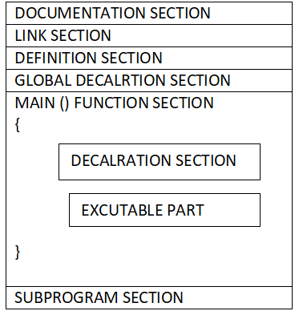
Structure of c program

Slide 4
Documentation section :-it consists of a set of comment lines giving the name of the program.
Line commenting: it uses two slashes (//) to identify the comment and it is used to comment entire line.
Block Commenting: it uses two pair of tokens /* and */ to comment entire block of code.

Slide 5
Link section :-It provides instructions to the compiler to link functions from the system library
Ex: #include<stdio.h>
#include<math.h>
Definition section defines all the symbolic constants .
ex:- #define PI 3.14
There are some variables that are used in more than one function .such variables are called global varibles.

Slide 6
Every c program must have one main () function section . These section contains two parts:
1) declaration part
2)executable part

Slide 7
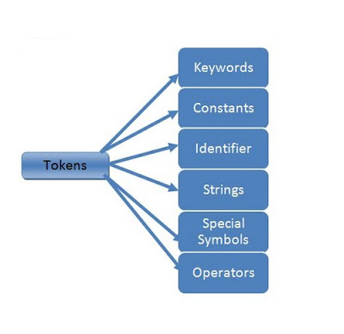
C –tokens
C language program can contain the individual units called the
c- tokens

Slide 8
Key words
There are certain words reserved for doing specific task, these words are known as reserved word or keywords.
These words are predefined and always written in lower case or small letter.
These keywords cann’t be used as a variable name as it assigned with fixed meaning.
There are 32 key words . Some examples are int, short, signed, unsigned, default, volatile, float, long, double, break, continue, typedef, static, do, for, union, return, while, do, extern, register, enum, case, goto, struct, char, auto, const etc

Slide 9
identifiers
Identifiers are user defined word used to name of entities like variables, arrays, functions, structures etc.
Rules for naming identifiers are:
name should only consists of alphabets (both upper and lower case), digits and underscore (_) sign.
first characters should be alphabet or underscore
name should not be a keyword
since C is a case sensitive, the upper case and lower case considered differently, for example code, Code, CODE etc. are different identifiers.
identifiers are generally given in some meaningful name such as value, net_salary, age, data etc

Slide 10
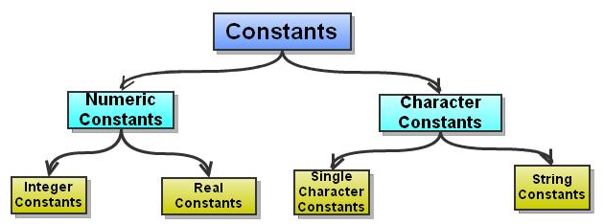
Constants
Constant is a any value that cannot be changed during program execution.

Slide 11
Integer constant: an integer constant formed with the sequence of digits. There are three types of integers.
decimal integer .(0 to 9)
Octal integer.(0 to 7)
Hexadecimal (0 to 9,a to f )
Real constant: (float constant)
It is a number with decimal point.

Slide 12
Character constant
Single character constant : a character constant contains a single character enclosed within a pair of single quote marks.
ex: ‘s’,’x’
String constant : a string constant is a sequence enclosed in double quotes. The characters may be letters
Ex:”hello”

Slide 13
variables
A variable is a data name that may be used to store data value.
Variable names may consist of letters ,digits and underscore.
Rules to follow for the variable names are:
They must begin with a letter.
It should not be keyword.
Examples of variable names :
123 -> not valid
first_tag -> vaild

Slide 14
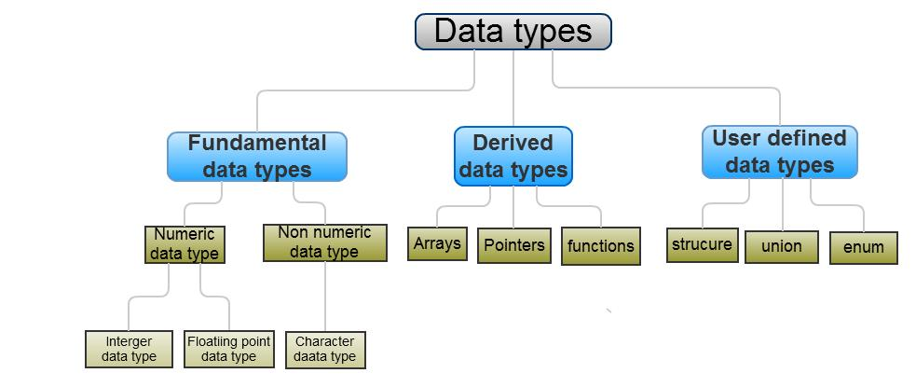
Data types
data type is used to indicate the type of data value stored in a variable.
C supports three classes of data types
1)primary data types
2)derived data types
3) user defined data type

Slide 15
Primary data types
Integer
Floating point
Character

Slide 16
Difference between signed and unsigned data type
signed data type can store both negative and positive values.
unsigned data type can store only positive values including zero

Slide 17
Integer data type
Integer data type: integers are used to store whole numbers with a range of values.
Integers are usually stored in 2 bytes
C has three class of integer storage namely
short int
Long int
Int

Slide 18
Character type: A single character can be defined as a character type data.
Characters are usually stored in 8 bits (one byte).
Floating point numbers are stored in 32 bits (4 bytes).

Slide 19
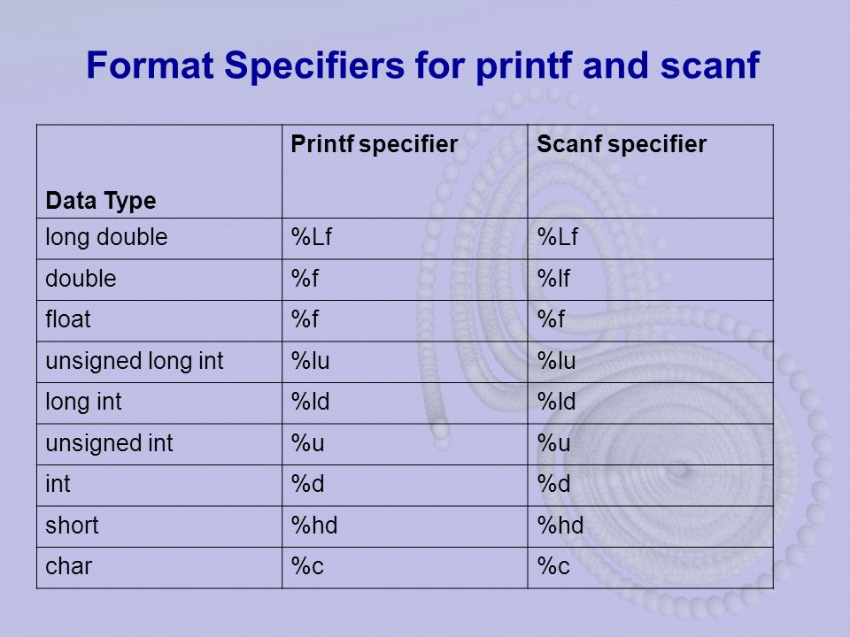

Slide 21
Declaration of Variables
Declaration does two things:
It tells the compiler what the variable name is.
It specifies what type of data the variable will hold.

Slide 22
Primary type declaration
A variable can be used to store a value of any data type.
A declaration statement begins with the type, followed by the name of one or more variables. The general form is:
data-type v₁,v₂,………,v_{n;}
int count;
Int number,total;

Slide 23
Assigning values to Variables
Values can be assigned to variables by using the assignment operator ‘=’. The general form is:
variable_name = constant;
Here a constant is the value of the variable. For example
i =0;
balance=0;
It is also possible to assign a value to a variable at the time of variable is declared. The general form is:
data-typevariable_name=constant;
For example
int count=0,sum=0;

Slide 24
Input /output
INPUT: The formatted input refers to input data that has been arranged in a particular format. Input values are generally taken by using the scanf function. The scanf function has the general form.
scanf (“control string”, arg1, arg2, …..arg n);
scanf (“%d %d”, &sum1, &sum2);
Output :.Output is mostly displayed on monitors.Output functions are: printf()

Slide 25
#include<stdio.h #include<conio.h>
void main()
{
int a,b,c; //declaring variables clrscr(); //clearing the output screen
printf("enter the value of a and b");
//formatted output statement
scanf("%d%d",&a,&b);
//formatted input statement c=a+b;
//a and b are added and stored in c
printf("%d",c); //variable c is printed
getch();
}

Slide 26
Operator:
Operator: An operator is a symbol that tells the computer to perform certain mathematical or logical manipulations.
Expression: An expression is a sequence of operands and operators that reduces to a single value. For example,
10 + 5
is an expression whose value is 15

Slide 27
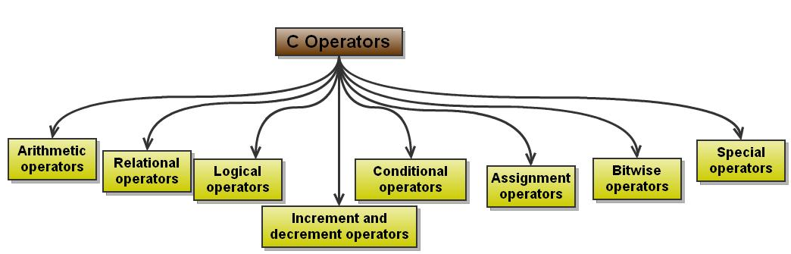

Slide 28
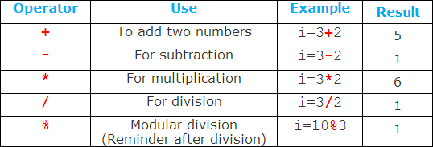
Classifications of Operators
Arithmetic Operators

Slide 29
Integer Arithmetic : When an arithmetic operation is performed on two whole numbers or integers than such an operation is called as integer arithmetic.
Floating point arithmetic :When an arithmetic operation is preformed on two real numbers or fraction numbers such an operation is called floating point arithmetic.

Slide 30
Mixed mode arithmetic
When one of the operand is real and other is an integer and if the arithmetic operation is carried out on these 2 operands then it is called as mixed mode arithmetic. If anyone operand is of real type then the result will always be real thus
15/10.0 = 1.5

Slide 31
Write a C-Program to perform the simple arithmetic operations.
Algorithm:
Step 1: Start
Step 2: Read the values of a,b
Step 3: Perform the addition c=a+b,
Subtraction d=a-b,
Multiplication e=a*b,
Division f=a/b
Step 4:print the values of c,d,e,f
Step 5: Stop

Slide 32
#include<stdio.h>
#include<conio.h>
void main()
{
int a,b,c,d,e;
float f;
clrscr();
printf("Enter the values of a,b:");
scanf("%d%d",&a,&b);
c=a+b;
d=a-b;
e=a*b;
f=(float)(a/b);
printf("\naddition of two numbers is:%d",c);
printf("\nsubtraction of two numbers is:%d",d);
printf("\nmultiplication of two numbers is:%d",e);
printf("\ndivision of two numbers is:%f",f);
getch();
}

Slide 33
/*Calculating of simple interest*/
#include<stdio.h>
#include<conio.h> int main()
{
int p,n;
float r,si;
p=1000;
n=3;
r=8.5;
/*formula for simple interest*/
si=p*n*r/100;
printf("%f\n",si);
return 0;
}

Slide 34
Relational operator
Relational operator are used to compare two OR more operands.

Slide 35
Logical operator
Logical operators are used to combine the results of two or more conditions .

Slide 36
Increment and decrement Operators (Unary Operators)
These operators are used to either increase or decrease the value of the variable by one.
They are
prefix increment(++a)
Prefix decrement(--a)
postfix increment(a++)
Postfix decrement(--a)

Slide 37
Suppose, a = 5 then,
++a; //a becomes 6
a++; //a becomes 7
--a; //a becomes 6
a--; //a becomes 5

Slide 38
Conditional operator (ternary operator )
The conditional operator consists of 2 symbols the question mark (?) and the colon(:)
Syntax: exp1? exp2: exp3
For example:
a = 10;
b = 15;
x = (a > b)? a: b

